Slide 1


Das nephrologische Jahr 2014/15
Ein Überblick
Jürgen Floege
Medizinische Klinik II
Klinik für Nieren- und Hochdruckkrankheiten
juergen.floege@rwth-aachen.de
Notes:
1

Slide 2

Hypertonie
Notes:
SC therapy of glomerular disease may still be far away but there is progress
eventually we will define which SC technology can be successfully used for which indication

Slide 3
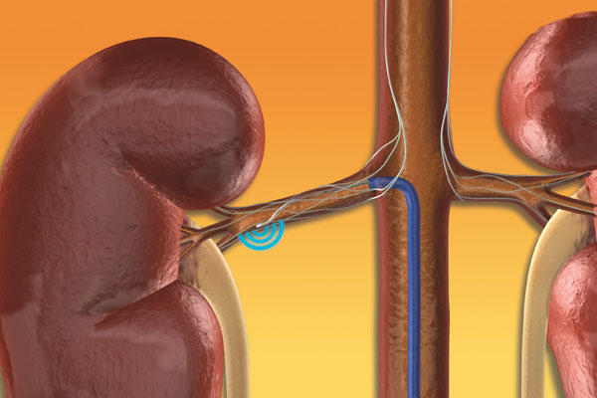
Renale Denervierung
Langzeiterfahrungen fehlen => nur für hochselektierte Patienten!
„….Deutschland ist das einzige Land der Welt, in dem nahtlos eine Phase I Studie in eine Phase IV Studie übergeht…..“

Slide 4
Bhatt DL et al,
N Engl J Med 2014; 370: 1393-401
Simplicity III
Studie:
Praxis-Blutdruck
Prospektiv, einfach verblindet, “sham-controlled”
Patienten hatten mindestens 3 Medikamente in maximal tolerierter Dosis incl. Diuretikum

Slide 5
Bhatt DL et al,
N Engl J Med 2014; 370: 1393-401
Simplicity III
Studie:
24h-Blutdruck

Slide 6
Plazebo-Effekte in Studien mit resistentem Blutdruck
Praxis
Syst RR (mmHg)
-12
-16
-9
-14
Modizifiert nach R. Wachter, Der Internist 3/2015

Slide 7
Simplicity III Studie: Kritikpunkte der DGK
Studienzentren hatten überwiegend wenig Erfahrung mit der Methode.
111 Untersucher, von denen 31% nur 1 Prozedur durchführten.
Denervierung nicht gut wirksam in Afroamerikanern, die ca. 25% der Patienten stellten
Medikamenten-Änderungen kurz vor und während der Studie: Teile der Blutdrucksenkung noch durch anhaltende Medikamentenwirkungen bedingt?

Slide 8

Fadl Elmula FE et al, Hypertension. 2014; 63: 991-9
Norwegische Studie zur renalen Denervierung
65 Patienten mit „Therapie-refraktärer Hypertonie“
(RR > 140 systolisch trotz 3 Medikamente in max. tolerierter Dosis incl. Diuretikum)
26 sekundäre oder zweifelhafte Hypertonie
20 Adhärenz- (Compliance) Problem
Normaler RR nach überwachter Einnahme
9 Pat. renale Denervierung:
RR 156/91 ⇨ 148/89
Initial 6 Monate
10 Pat. optimierte Medikation:
RR 160/88 ⇨ 132/77
Initial 6 Monate
Studie aus ethischen Gründen abgebrochen
Notes:
We aimed to investigate for the first time the blood pressure (BP)–lowering effect of renal sympathetic denervation (RDN) versus clinically adjusted drug treatment in true treatment-resistant hypertension (TRH) after excluding patients with confounding poor drug adherence. Patients with apparent TRH (n=65) were referred for RDN, and those with secondary and spurious hypertension (n=26) were excluded. TRH was defined as office systolic BP (SBP) >140 mm Hg, despite maximally tolerated doses of ≥3 antihypertensive drugs including a diuretic. In addition, ambulatory daytime SBP >135 mm Hg after witnessed intake of antihypertensive drugs was required, after which 20 patients had normalized BP and were excluded. Patients with true TRH were randomized and underwent RDN (n=9) performed with Symplicity Catheter System versus clinically adjusted drug treatment (n=10). The study was stopped early for ethical reasons because RDN had uncertain BP-lowering effect. Office SBP and diastolic BP in the drug-adjusted group changed from 160±14/88±13 mm Hg (±SD) at baseline to 132±10/77±8 mm Hg at 6 months (P<0.0005 and P=0.02, SBP and diastolic BP, respectively) and in the RDN group from 156±13/91±15 to 148±7/89±8 mm Hg (P=0.42 and P=0.48, SBP and diastolic BP, respectively). SBP and diastolic BP were significantly lower in the drug-adjusted group at 6 months (P=0.002 and P=0.004, respectively), and absolute changes in SBP were larger in the drug-adjusted group (P=0.008). Ambulatory BPs changed in parallel to office BPs. Our data suggest that adjusted drug treatment has superior BP lowering effects compared with RDN in patients with true TRH.

Slide 9
Azizi et al., Lancet. 2015
DENERHTN – renale Denervierung in Europa
1416 Patienten mit „therapierefraktärer Hypertonie“
1207 ausgeschlossen; 709 mit sek. Hypertonie, Rest andere Gründe
53 renal denerviert, 53 Kontrollen
Häuslicher Blutdruck
Praxis-Blutdruck

Slide 10
Gemeinsame Stellungnahme der
Deutschen Hochdruckliga, Gesellschaft für Kardiologie,
Angiologie, Nephrologie und Röntgen Gesellschaft
zur renalen Denervation bei Patienten
mit nicht-kontrollierter arterieller Hypertonie
Diagnostik und Nachverfolgung auf spezialisierte Zentren beschränkt
nur von erfahrenen Interventionalisten durchgeführt
Patienten müssen vollständig in einem Register (möglichst industrieunabhängig) gemeldet werden
weitere randomisierte, kontrollierte Studien in Deutschland sind nötig

Slide 11
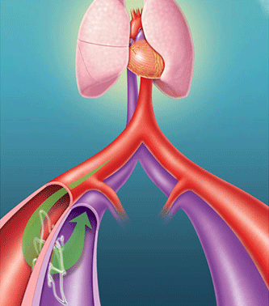
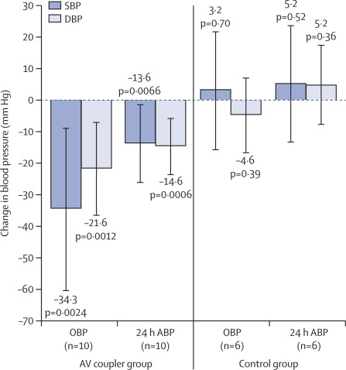
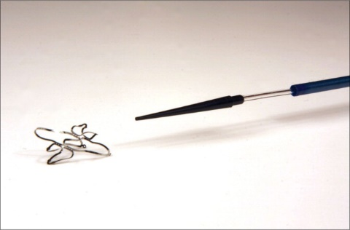
Melvin DL et al, Lancet 23.1.2015
Zentrale AV-Anastomse zur Therapie der
unkontrollierten Hypertonie (ROX CONTROL HTN Studie)
Notes:
Central arteriovenous anastomosis for the treatment of
patients with uncontrolled hypertension (the ROX CONTROL
HTN study): a randomised controlled trial
Melvin D Lobo, Paul A Sobotka, Alice Stanton, John R Cockcroft, Neil Sulke, Eamon Dolan, Markus van der Giet, Joachim Hoyer, Stephen S Furniss,
John P Foran, Adam Witkowski, Andrzej Januszewicz, Danny Schoors, Konstantinos Tsioufi s, Benno J Rensing, Benjamin Scott, G André Ng,
Christian Ott, Roland E Schmieder, for the ROX CONTROL HTN Investigators*
Summary
Background Hypertension contributes to cardiovascular morbidity and mortality. We assessed the safety and effi cacy
of a central iliac arteriovenous anastomosis to alter the mechanical arterial properties and reduce blood pressure in
patients with uncontrolled hypertension.
Methods We enrolled patients in this open-label, multicentre, prospective, randomised, controlled trial between
October, 2012, and April, 2014. Eligible patients had baseline offi ce systolic blood pressure of 140 mm Hg or higher
and average daytime ambulatory blood pressure of 135 mm Hg or higher systolic and 85 mm Hg or higher diastolic
despite antihypertensive treatment. Patients were randomly allocated in a 1:1 ratio to undergo implantation of an
arteriovenous coupler device plus current pharmaceutical treatment or to maintain current treatment alone (control).
The primary endpoint was mean change from baseline in offi ce and 24 h ambulatory systolic blood pressure at
6 months. Analysis was by modifi ed intention to treat (all patients remaining in follow-up at 6 months). This trial is
registered with ClinicalTrials.gov, number NCT01642498.
Findings 83 (43%) of 195 patients screened were assigned arteriovenous coupler therapy (n=44) or normal care (n=39).
Mean offi ce systolic blood pressure reduced by 26·9 (SD 23·9) mm Hg in the arteriovenous coupler group (p<0·0001)
and by 3·7 (21·2) mm Hg in the control group (p=0·31). Mean systolic 24 h ambulatory blood pressure reduced by
13·5 (18·8) mm Hg (p<0·0001) in arteriovenous coupler recipients and by 0·5 (15·8) mm Hg (p=0·86) in controls.
Implantation of the arteriovenous coupler was associated with late ipsilateral venous stenosis in 12 (29%) of 42 patients
and was treatable with venoplasty or stenting.
Interpretation Arteriovenous anastomosis was associated with signifi cantly reduced blood pressure and hypertensive
complications. This approach might be a useful adjunctive therapy for patients with uncontrolled hypertension.

Slide 12
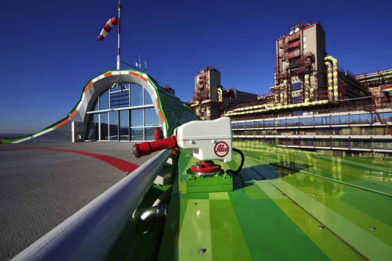
Quintessenz
Renale Denervierung ist nicht die Universal-Lösung….
Die große Mehrheit von „therapie-refraktären“ Hypertonikern ist nicht therapie-refraktär und kann in spezialisierten Zentren effektiv behandelt werden
Ob renale Denervierung (oder gar die AV-Fistel) eine Zukunft hat, ist derzeit unklar

Slide 13
Diabetische Nephropathie
Notes:
SC therapy of glomerular disease may still be far away but there is progress
eventually we will define which SC technology can be successfully used for which indication

Slide 14
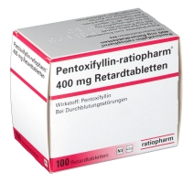
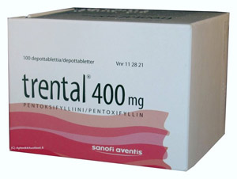
Eine alte Substanz neu entdeckt: Pentoxifyllin
Phosphodiesterase-Hemmer
Einfluss auf cAMP ⇨ Vasodilatation
senkt Blutviskosität durch bessere Verformbarkeit der Erythrozyten
Senkt Plasmafibrinogen
Verordnung von Rheologika umstritten
Anti-inflammatorische Wirkung:
hemmt Interleukin und TNF-α Freisetzung
Degranulationshemmung von Neutrophilen
synergistischer Effekt mit Corticosteroiden

Slide 15
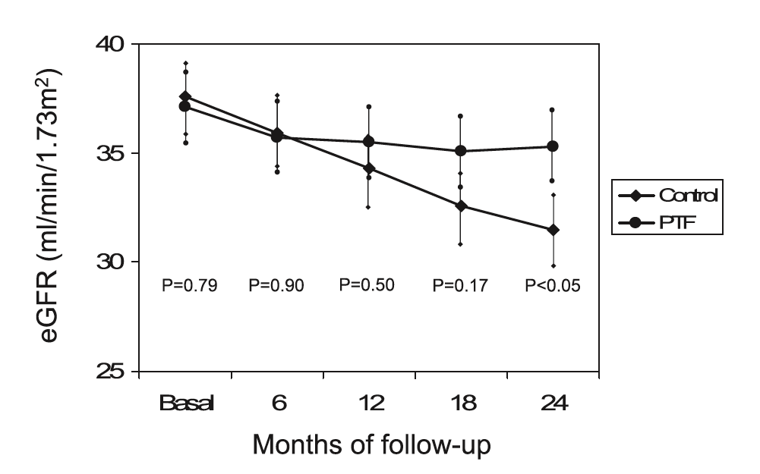
Kohan DE et al. JASN 2014; in press
Pentoxifyllin bei diabetischer Nephropathie
Open label, prospektive, randomisierte Studie; 169 Patienten mit Typ 2 DM
1200 mg Pentoxifyllin + RAAS-Blockade

Slide 16
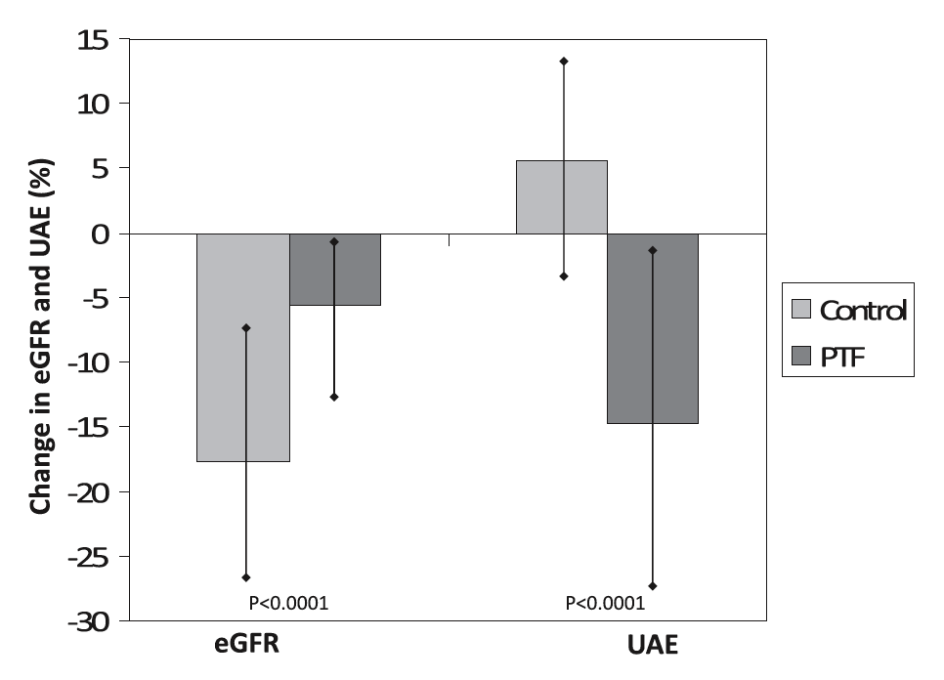
Kohan DE et al. JASN 2014; in press
Pentoxifyllin bei diabetischer Nephropathie
Albuminurie

Slide 17
Quintessenz
Bei Diabetikern mit CKD III-IV senkt Pentoxifyllin die Albuminurie und
stabilisiert die GFR

Slide 18
Akutes Nierenversagen
(AKI)
Notes:
SC therapy of glomerular disease may still be far away but there is progress
eventually we will define which SC technology can be successfully used for which indication

Slide 19
Wilson FP et al. Lancet 2015; 385: 1966–74
Randomisierte Studie (Philadelphia, USA):
Elektronische AKI-Warnsysteme im Krankenhaus
KDIGO
Kreatinin-basierte
AKI-Definition
Automatische Computer-generierte
AKI-Warnung an behandelnden Arzt + Pharmazeuten (n = 1201)
Randomisierung
“Usual care” (n = 1192)
Notes:
Background Acute kidney injury often goes unrecognised in its early stages when eff ective treatment options might be
available. We aimed to determine whether an automated electronic alert for acute kidney injury would reduce the
severity of such injury and improve clinical outcomes in patients in hospital.
Methods In this investigator-masked, parallel-group, randomised controlled trial, patients were recruited from the
hospital of the University of Pennsylvania in Philadelphia, PA, USA. Eligible participants were adults aged 18 years or
older who were in hospital with stage 1 or greater acute kidney injury as defi ned by Kidney Disease Improving Global
Outcomes creatinine-based criteria. Exclusion criteria were initial hospital creatinine 4·0 mg/dL (to convert to
μmol/L, multiply by 88·4) or greater, fewer than two creatinine values measured, inability to determine the covering
provider, admission to hospice or the observation unit, previous randomisation, or end-stage renal disease. Patients
were randomly assigned (1:1) via a computer-generated sequence to receive an acute kidney injury alert (a text-based
alert sent to the covering provider and unit pharmacist indicating new acute kidney injury) or usual care, stratifi ed by
medical versus surgical admission and intensive care unit versus non-intensive care unit location in blocks of
4–8 participants. The primary outcome was a composite of relative maximum change in creatinine, dialysis, and
death at 7 days after randomisation. All analyses were by intention to treat. This study is registered with ClinicalTrials.
gov, number NCT01862419.
Findings Between Sept 17, 2013, and April 14, 2014, 23 664 patients were screened. 1201 eligible participants were
assigned to the acute kidney injury alert group and 1192 were assigned to the usual care group. Composite relative
maximum change in creatinine, dialysis, and death at 7 days did not diff er between the alert group and the usual
care group (p=0·88), or within any of the four randomisation strata (all p>0·05). At 7 days after randomisation,
median maximum relative change in creatinine concentrations was 0·0% (IQR 0·0–18·4) in the alert group and
0·6% (0·0–17·5) in the usual care group (p=0·81); 87 (7·2%) patients in the alert group and 70 (5·9%) patients in
usual care group had received dialysis (odds ratio 1·25 [95% CI 0·90–1·74]; p=0·18); and 71 (5·9%) patients in the
alert group and 61 (5·1%) patients in the usual care group had died (1·16 [0·81–1·68]; p=0·40).
Interpretation An electronic alert system for acute kidney injury did not improve clinical outcomes among patients
in hospital.

Slide 20
Wilson FP et al. Lancet 2015; 385: 1966–74
Randomisierte Studie (Philadelphia, USA):
Elektronische AKI-Warnsysteme im Krankenhaus
Ereignisse, n (%) Alerts Usual Odds ratio p
Pro Alerts
Pro Usual care
Notes:
Background Acute kidney injury often goes unrecognised in its early stages when eff ective treatment options might be
available. We aimed to determine whether an automated electronic alert for acute kidney injury would reduce the
severity of such injury and improve clinical outcomes in patients in hospital.
Methods In this investigator-masked, parallel-group, randomised controlled trial, patients were recruited from the
hospital of the University of Pennsylvania in Philadelphia, PA, USA. Eligible participants were adults aged 18 years or
older who were in hospital with stage 1 or greater acute kidney injury as defi ned by Kidney Disease Improving Global
Outcomes creatinine-based criteria. Exclusion criteria were initial hospital creatinine 4·0 mg/dL (to convert to
μmol/L, multiply by 88·4) or greater, fewer than two creatinine values measured, inability to determine the covering
provider, admission to hospice or the observation unit, previous randomisation, or end-stage renal disease. Patients
were randomly assigned (1:1) via a computer-generated sequence to receive an acute kidney injury alert (a text-based
alert sent to the covering provider and unit pharmacist indicating new acute kidney injury) or usual care, stratifi ed by
medical versus surgical admission and intensive care unit versus non-intensive care unit location in blocks of
4–8 participants. The primary outcome was a composite of relative maximum change in creatinine, dialysis, and
death at 7 days after randomisation. All analyses were by intention to treat. This study is registered with ClinicalTrials.
gov, number NCT01862419.
Findings Between Sept 17, 2013, and April 14, 2014, 23 664 patients were screened. 1201 eligible participants were
assigned to the acute kidney injury alert group and 1192 were assigned to the usual care group. Composite relative
maximum change in creatinine, dialysis, and death at 7 days did not diff er between the alert group and the usual
care group (p=0·88), or within any of the four randomisation strata (all p>0·05). At 7 days after randomisation,
median maximum relative change in creatinine concentrations was 0·0% (IQR 0·0–18·4) in the alert group and
0·6% (0·0–17·5) in the usual care group (p=0·81); 87 (7·2%) patients in the alert group and 70 (5·9%) patients in
usual care group had received dialysis (odds ratio 1·25 [95% CI 0·90–1·74]; p=0·18); and 71 (5·9%) patients in the
alert group and 61 (5·1%) patients in the usual care group had died (1·16 [0·81–1·68]; p=0·40).
Interpretation An electronic alert system for acute kidney injury did not improve clinical outcomes among patients
in hospital.

Slide 21
Wilson FP et al. Lancet 2015; 385: 1966–74
Randomisierte Studie (Philadelphia, USA):
Elektronische AKI-Warnsysteme im Krankenhaus
Elektronische Alerts:
Ohne Verbesserung der klinischen Prognose
Ohne Einfluß auf nephroprotektive Maßnahmen
Ohne Einfluß auf weitere Diagnostik
Ohne Einfluß auf AKI-Dokumentation
Einmalige bzw. passive Information über AKI ist unwirksam
Nephroprotektive Maßnahme bleiben auf niedrigem Niveau
☞ Bedarf für ein AKI-Team mit Akutbehandlung + Nachbeobachtung über die Sektorengrenze hinaus
Notes:
Background Acute kidney injury often goes unrecognised in its early stages when eff ective treatment options might be
available. We aimed to determine whether an automated electronic alert for acute kidney injury would reduce the
severity of such injury and improve clinical outcomes in patients in hospital.
Methods In this investigator-masked, parallel-group, randomised controlled trial, patients were recruited from the
hospital of the University of Pennsylvania in Philadelphia, PA, USA. Eligible participants were adults aged 18 years or
older who were in hospital with stage 1 or greater acute kidney injury as defi ned by Kidney Disease Improving Global
Outcomes creatinine-based criteria. Exclusion criteria were initial hospital creatinine 4·0 mg/dL (to convert to
μmol/L, multiply by 88·4) or greater, fewer than two creatinine values measured, inability to determine the covering
provider, admission to hospice or the observation unit, previous randomisation, or end-stage renal disease. Patients
were randomly assigned (1:1) via a computer-generated sequence to receive an acute kidney injury alert (a text-based
alert sent to the covering provider and unit pharmacist indicating new acute kidney injury) or usual care, stratifi ed by
medical versus surgical admission and intensive care unit versus non-intensive care unit location in blocks of
4–8 participants. The primary outcome was a composite of relative maximum change in creatinine, dialysis, and
death at 7 days after randomisation. All analyses were by intention to treat. This study is registered with ClinicalTrials.
gov, number NCT01862419.
Findings Between Sept 17, 2013, and April 14, 2014, 23 664 patients were screened. 1201 eligible participants were
assigned to the acute kidney injury alert group and 1192 were assigned to the usual care group. Composite relative
maximum change in creatinine, dialysis, and death at 7 days did not diff er between the alert group and the usual
care group (p=0·88), or within any of the four randomisation strata (all p>0·05). At 7 days after randomisation,
median maximum relative change in creatinine concentrations was 0·0% (IQR 0·0–18·4) in the alert group and
0·6% (0·0–17·5) in the usual care group (p=0·81); 87 (7·2%) patients in the alert group and 70 (5·9%) patients in
usual care group had received dialysis (odds ratio 1·25 [95% CI 0·90–1·74]; p=0·18); and 71 (5·9%) patients in the
alert group and 61 (5·1%) patients in the usual care group had died (1·16 [0·81–1·68]; p=0·40).
Interpretation An electronic alert system for acute kidney injury did not improve clinical outcomes among patients
in hospital.

Slide 22
Quintessenz
Unzureichende AKI-Versorgung
Elektronische Warnsysteme allein sind nicht die Lösung!

Slide 23
Chronische Niereninsuffizienz
Notes:
SC therapy of glomerular disease may still be far away but there is progress
eventually we will define which SC technology can be successfully used for which indication

Slide 24
CKD-Stadium und Überweisung zum Nephrologen
KDIGO-Leitlinien 2013
www.kdigo.org

Slide 25
Thompson S et al, J Am Soc Nephrol 2015; 26: im Druck
Todesursachen je nach CKD-Stadium
81.064 Todesfälle in Alberta, Kanada 2002-2009 [%]
0
25
50
75
100
100
andere
75
Infektion
50
Malignom
Prozent der Todesfälle
25
Kardiovaskulär
0
GFR-Kategorie: >60 (ohne Proteinurie) 60 + Prot. 45-59 30-44 15-29

Slide 26
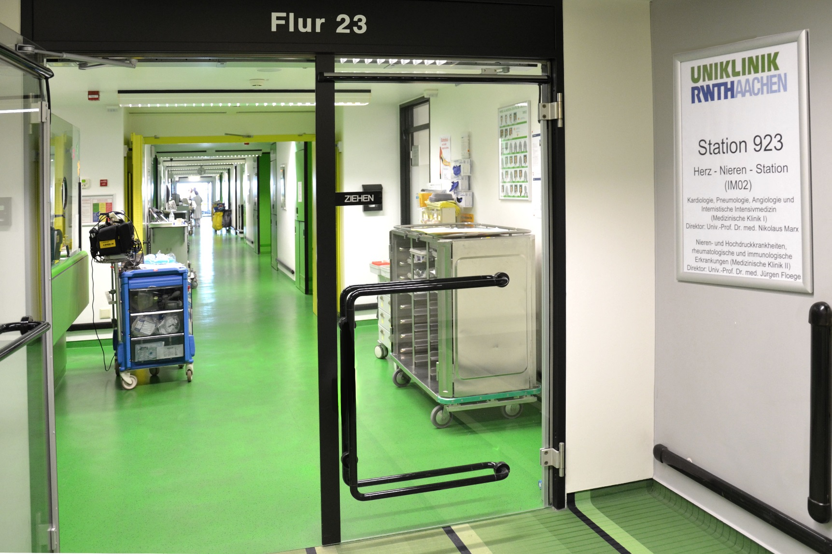

Slide 27
Hsu T-W et al. JAMA Intern Med 2014;174:347-54
RAAS-Blockade bei hochgradiger Niereninsuffizienz (CKD V)
Ramipril: Gegenanzeigen und Alternativen
Der Wirkstoff Ramipril …… ungeeignet … für Menschen mit Verengungen der Nierenarterien und der Herzklappen sowie schweren Funktionsstörungen der Nieren.
Prospektive Kohorten Studie an 28.497 hypertensiven Patienten mit CKD mit Kreatinin > 6 mg/dl
Mittleres Follow-up: 7 Monate
ACEIs/ARBs: 14.117 Patienten; ohne: 14.380 Patienten
Ergebnisse:
71% wurden dialysepflichtig
20% verstarben vor Dialyseeinleitung

Slide 28
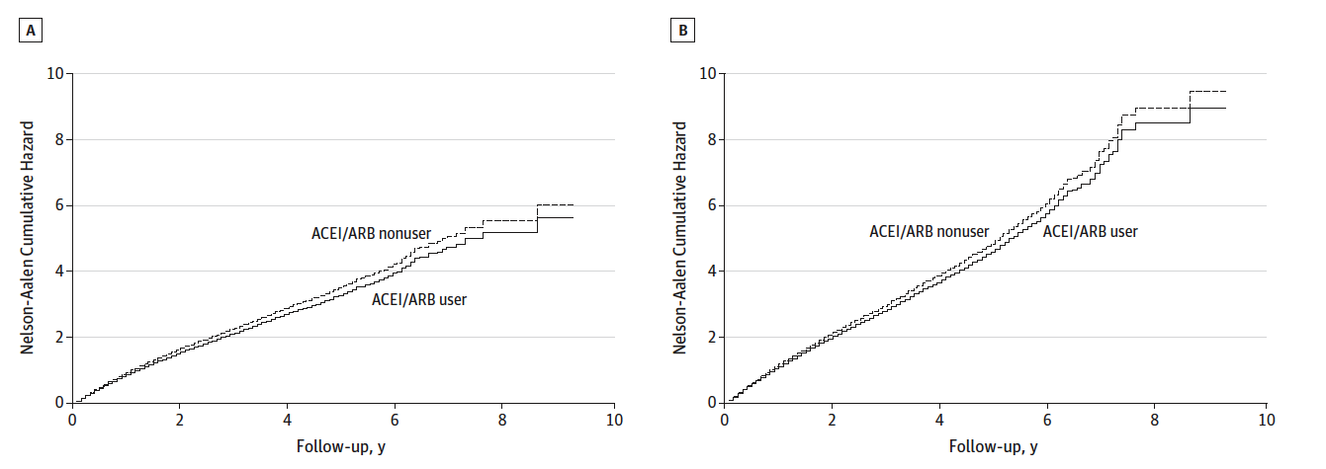
Hsu T-W et al. JAMA Intern Med 2014;174:347-54
RAAS-Blockade bei hochgradiger Niereninsuffizienz (CKD V)
Risiko für Dialysepflichtigkeit
Risiko für Dialyse und Tod
ACEi/ARB user:
-6% Risiko
ACEi/ARB user:
-6% Risiko
ACEi/ARB: mehr Hyperkaliämie-assoz. Hospitalisation ohne erhöhte Mortalität.

Slide 29
Packham DK et al, N Engl J Med 2015; 372: 222-31
Natrium-Zirkonium-Cyclosilikat als Kalium-Binder
Notes:
Background
Hyperkalemia (serum potassium level, >5.0 mmol per liter) is associated with increased
mortality among patients with heart failure, chronic kidney disease, or
diabetes. We investigated whether sodium zirconium cyclosilicate (ZS-9), a novel
selective cation exchanger, could lower serum potassium levels in patients with
hyperkalemia.
Methods
In this multicenter, two-stage, double-blind, phase 3 trial, we randomly assigned
753 patients with hyperkalemia to receive either ZS-9 (at a dose of 1.25 g, 2.5 g, 5 g,
or 10 g) or placebo three times daily for 48 hours. Patients with normokalemia
(serum potassium level, 3.5 to 4.9 mmol per liter) at 48 hours were randomly assigned
to receive either ZS-9 or placebo once daily on days 3 to 14 (maintenance phase). The
primary end point was the exponential rate of change in the mean serum potassium
level at 48 hours.
Results
At 48 hours, the mean serum potassium level had decreased from 5.3 mmol per
liter at baseline to 4.9 mmol per liter in the group of patients who received 2.5 g of
ZS-9, 4.8 mmol per liter in the 5-g group, and 4.6 mmol per liter in the 10-g group,
for mean reductions of 0.5, 0.5, and 0.7 mmol per liter, respectively (P<0.001 for all
comparisons) and to 5.1 mmol per liter in the 1.25-g group and the placebo group
(mean reduction, 0.3 mmol per liter). In patients who received 5 g of ZS-9 and those
who received 10 g of ZS-9, serum potassium levels were maintained at 4.7 mmol per
liter and 4.5 mmol per liter, respectively, during the maintenance phase, as compared
with a level of more than 5.0 mmol per liter in the placebo group (P<0.01 for
all comparisons). Rates of adverse events were similar in the ZS-9 group and the
placebo group (12.9% and 10.8%, respectively, in the initial phase; 25.1% and 24.5%,
respectively, in the maintenance phase). Diarrhea was the most common complication
in the two study groups.
Conclusions
Patients with hyperkalemia who received ZS-9, as compared with those who received
placebo, had a significant reduction in potassium levels at 48 hours, with
normokalemia maintained during 12 days of maintenance therapy. (Funded by ZS
Pharma; ClinicalTrials.gov number, NCT01737697.)

Slide 30
Weir MR et al, N Engl J Med 2015; 372: 211-21
Patiromer als Kalium-Binder
Notes:
Background
Hyperkalemia increases the risk of death and limits the use of inhibitors of the
renin–angiotensin–aldosterone system (RAAS) in high-risk patients. We assessed the
safety and efficacy of patiromer, a nonabsorbed potassium binder, in a multicenter,
prospective trial.
Methods
Patients with chronic kidney disease who were receiving RAAS inhibitors and who
had serum potassium levels of 5.1 to less than 6.5 mmol per liter received patiromer
(at an initial dose of 4.2 g or 8.4 g twice a day) for 4 weeks (initial treatment phase);
the primary efficacy end point was the mean change in the serum potassium level
from baseline to week 4. Eligible patients at the end of week 4 (those with a baseline
potassium level of 5.5 to <6.5 mmol per liter in whom the level decreased to 3.8 to
<5.1 mmol per liter) entered an 8-week randomized withdrawal phase in which they
were randomly assigned to continue patiromer or switch to placebo; the primary
efficacy end point was the between-group difference in the median change in the
serum potassium level over the first 4 weeks of that phase.
Results
In the initial treatment phase, among 237 patients receiving patiromer who had at
least one potassium measurement at a scheduled visit after day 3, the mean (±SE)
change in the serum potassium level was −1.01±0.03 mmol per liter (P<0.001). At
week 4, 76% (95% confidence interval, 70 to 81) of the patients had reached the
target potassium level (3.8 to <5.1 mmol per liter). Subsequently, 107 patients were
randomly assigned to patiromer (55 patients) or placebo (52 patients) for the randomized
withdrawal phase. The median increase in the potassium level from baseline
of that phase was greater with placebo than with patiromer (P<0.001); a recurrence
of hyperkalemia (potassium level, ≥5.5 mmol per liter) occurred in 60% of the
patients in the placebo group as compared with 15% in the patiromer group
through week 8 (P<0.001). Mild-to-moderate constipation was the most common
adverse event (in 11% of the patients); hypokalemia occurred in 3%.
Conclusions
In patients with chronic kidney disease who were receiving RAAS inhibitors and
who had hyperkalemia, patiromer treatment was associated with a decrease in serum
potassium levels and, as compared with placebo, a reduction in the recurrence
of hyperkalemia. (Funded by Relypsa; OPAL-HK ClinicalTrials.gov number,
NCT01810939.)

Slide 31


Palmer SC et al. Nephrol Dial Transplant. 2014; 29:1377-84
Flüssigkeitszufuhr,
GFR-Verlust und Mortalität
Prospektive Kohorten-Studie an
3858 über
49-jährigen Australiern.
Tägl. Flüssig-keitszufuhr
aus Nahrung
+ Getränken (ohne Wasser) über Frage-bogen erfasst.

Slide 32
Palmer SC et al. Nephrol Dial Transplant. 2014; 29:1377-84
Flüssigkeitszufuhr,
GFR-Verlust und Mortalität
 | Tägliche Flüssigkeitszufuhr [Liter]
 | <2 | 2-2,4 | 2,5-2,9 | >3 | p
Delta eGFR intial bis Studienende [ml/min] (SD) | -2,4 (11,7) | -2,3 (9,7) | -2,6 (12,0) | -1,5 (10,5) | 0,7

Slide 33
Labonte ED, ASN-Kongress 2014
Eine neue Substanz-Klasse:
Hemmer der Natrium-Protonenpumpe-3
Erste Substanz: Tenapanor (Astra-Zeneca + Ardelyx)
Tierexperimentell:
Reduktion der GI-Natrium- und Phosphat-Absorption
Reduktion kardialer, renaler und vaskulärer Schäden incl. Verkalkung
Phase I Studie human:
Natrium steigt 20-50 mmol/die
Phosphat im Stuhl verdoppelt sich (ähnlich wie 15 g Sevelamer)
Phase IIb Dialyse-Patienten (Pressemeldung Ardelyx 2/2015):
significant dose-related decrease in serum phosphate levels
…rate of diarrhea and discontinuations due to diarrhea higher than expected based on previous clinical trials…

Slide 34

Quintessenz
Rechtzeitige Überweisung an Nephro(kardio)logen
RAAS-Blocker nicht absetzen bei progredienter Niereninsuffizienz
Hyperkaliämie unter RAAS-Blocker: Sie können die neuen Kalium-Senker einsetzen
(oder ein Schleifen-Diuretikum….!)
Viel Flüssigkeit ist nicht protektiv
Natrium-Protonenpumpe-3 Hemmer

Slide 35
Nierentransplantation
Notes:
SC therapy of glomerular disease may still be far away but there is progress
eventually we will define which SC technology can be successfully used for which indication

Slide 36
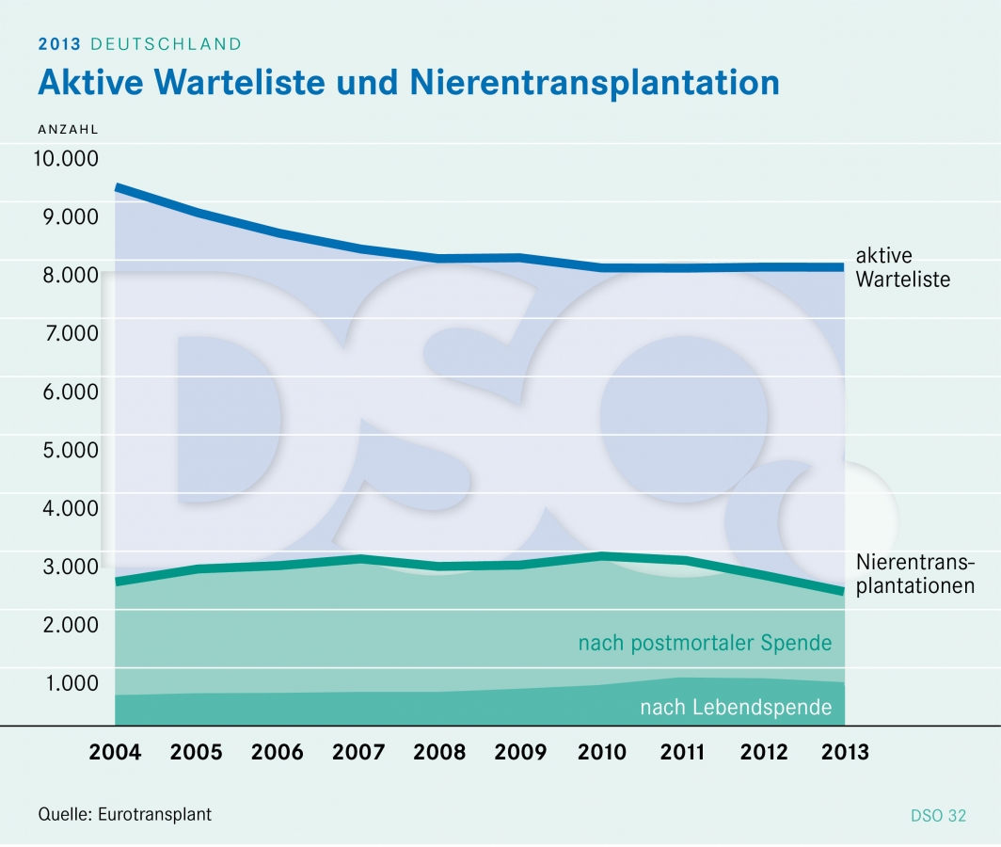
www.dso.de
Nieren-transplan-tation
Deutschland 2004-2013

Slide 37
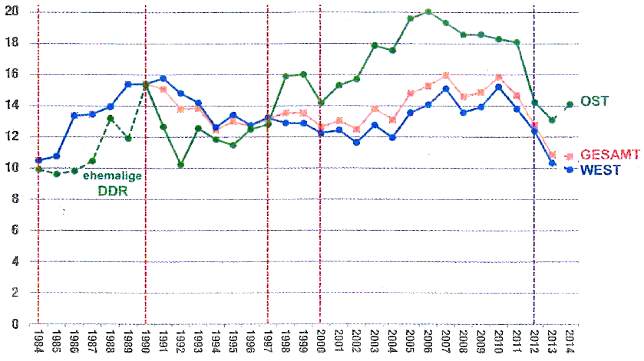
Deutsches Ärzteblatt 2015; 112: 569
Postmortale Organspenden pro Million Einwohner
Deutschland 1984-2014
Koordi-nierungs-
Stelle: DSO
Gründung
DSO
Wieder-
vereinigung
TX-
Gesetz
„TX-
Skandal“
Ost
Gesamt
West

Slide 38
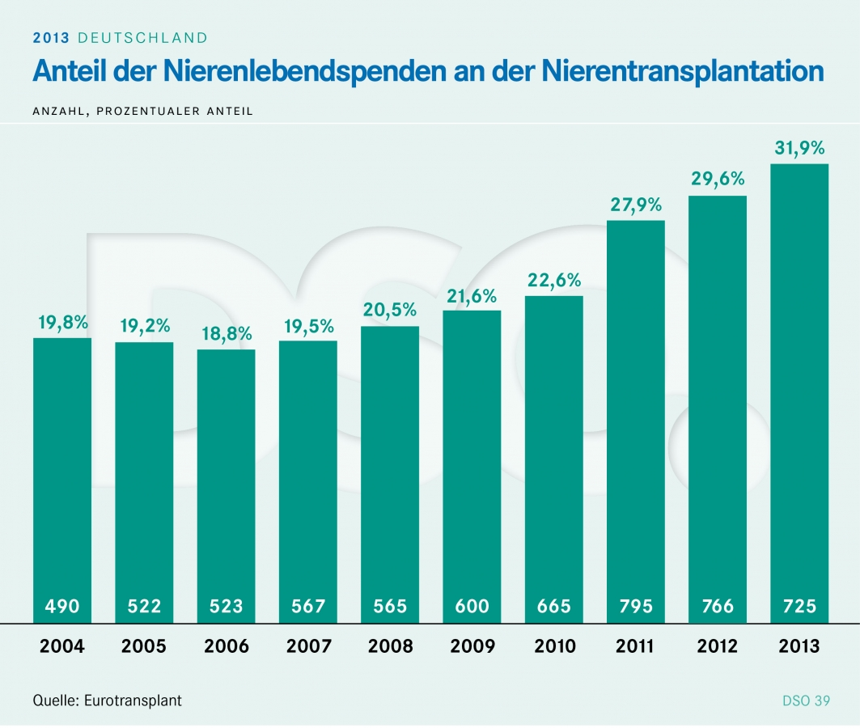
www.dso.de
Nieren-transplan-tation
Deutschland 2004-2013

Slide 39
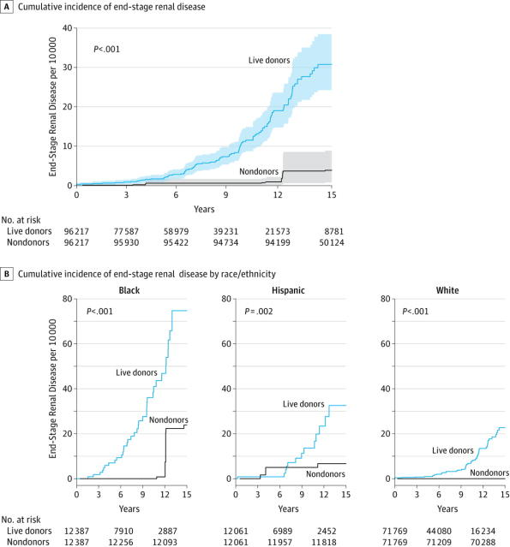
Muzaale A et al. JAMA 2014; 311, 579-586
= 0,10%
Terminale Nieren-insuffizienz bei Lebend-Nierenspende 1994-2011 (USA)
= 0,07%

Slide 40
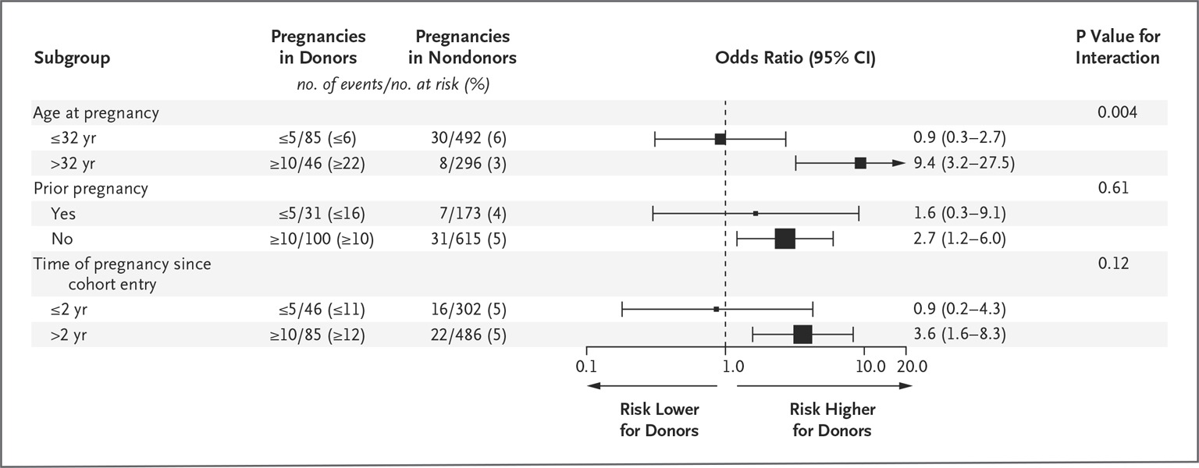
Garg AX, et al. N Engl J Med 372, 124-133, 2015
Nierenspende und Risiko
Schwangerschaftshypertonie oder Präeklampsie
n=85 Donoren, n= 510 Nichtdonoren; Ontario/Kanada
Frühgeburt, niedriges Geburtsgewicht: nicht verschieden
Keine Totgeburt, kein kindlicher oder maternaler Tod
Garg AX et al. N Engl J Med 2015;372:124-133
Notes:
Bei Nierenspenderinnen treten in einer nachfolgenden Schwangerschaft vermehrt Hypertonie und Präeklampsie auf.
Es fand sich jedoch kein Einfluss auf „pre-term“ Entbindung oder Geburtsgewicht.
Muss in die Aufklärungsgespräche vor Nierenspende miteinbezogen und unter dem Aspekt weiterer Risikofaktoren besprochen werden

Slide 41

gesundheit
11. Januar 2015, 16:59 Krankenhaus bei Bremen Schwere Panne bei Organ-Entnahme
Erst in letzter Minute fiel auf, dass der Nachweis fehlte: In einem norddeutschen Krankenhaus wurde ein Mensch ohne die vorgeschriebenen Untersuchungen zum Hirntoten erklärt. Beinahe hätte man ihm Spenderorgane entnommen.
Von Christina Berndt
Fast alles war gut vorbereitet: Der Organspender lag im Operationssaal, seine Organe waren der Stiftung Eurotransplant zum Verteilen gemeldet worden. Manche Patienten freuten sich wohl schon, dass sie endlich ein Organ bekommen würden. Doch nachdem einer der Chirurgen dem Organspender den Bauch aufgeschnitten hatte, fiel plötzlich auf, dass der Spender womöglich gar nicht tot war: Sein Hirntod war nicht nach den dafür vorgeschriebenen Regeln nachgewiesen worden. Unter keinen Umständen durften nun Organe entnommen werden - die Chirurgen würden sich der Tötung schuldig machen. Flugs wurde das ganze Prozedere abgebrochen.
Der Fall, der sich nach SZ-Informationen Anfang Dezember 2014 in einem Krankenhaus im Raum Bremen/Bremerhaven ereignete, sorgt derzeit für erhebliche Aufregung unter den Beteiligten. Mitarbeiter erzählten Kollegen unter Tränen von dem Vorfall, andere kündigten an, sich nun ganz aus der Organspende zurückziehen zu wollen. "Es ist gut möglich, dass das Gehirn dieses Menschen schon so weit geschädigt war, dass er nie wieder ins normale Leben zurückgefunden hätte", sagt ein Insider, der anonym bleiben will. "Aber solange der Hirntod nicht korrekt diagnostiziert worden ist, weiß das eben niemand."
Notes:
Christina Berndt: fest im Dienst der Interessengemeinschaft Niere (= erkläre Lebendspende-Gegner); Hohes Sendungsbewusstsein

Slide 42

Nierentransplantation
INITIATIVE
Die „Initiative Nierentransplantation“, eine aus der Kampagne 2014 „Ihr Nieren liegen uns am Herzen“ hervorgegangene Kooperation, will erreichen, dass Dialysepatienten auf der Warteliste wieder eine zeitnahe Option auf eine Nierentransplantation erhalten.

Slide 43


Wer steht hinter der Initiative?
Die gesamte Nephrologie in Deutschland.

Slide 44
5-Punkte-Maßnahmenkatalog
Aufnahme der Erklärung pro oder kontra Organspende
auf der elektronischen Gesundheitskarte
1
Aufbau eines umfassenden Transplantationsregisters
2
Bessere Patientenaufklärung und mehr Mittel zur Erforschung möglicher Risiken für Nierenlebendspender
3
Stärkung der Transplantationsbeauftragten in den Kliniken
4
Gezielte Öffentlichkeitsarbeit für die Notlage von Nierenpatienten
5

Slide 45
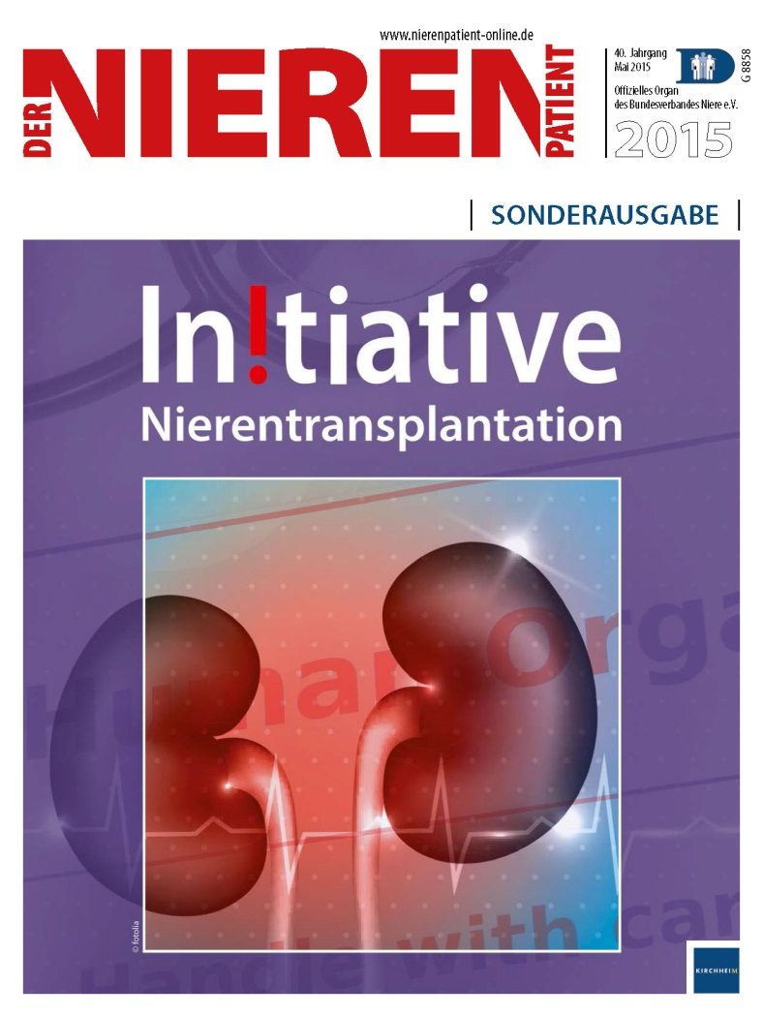
Sonderausgabe
Veröffentlichung eines Sonderheftes des „Der Nierenpatient“, Auslieferung an Gesundheitspolitiker und anderer KOLs im Gesundheitswesen

Slide 46
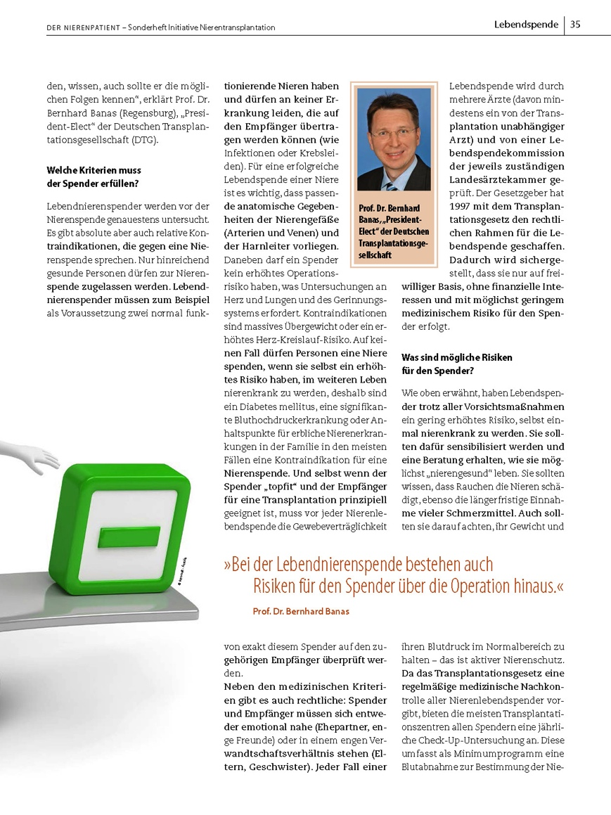
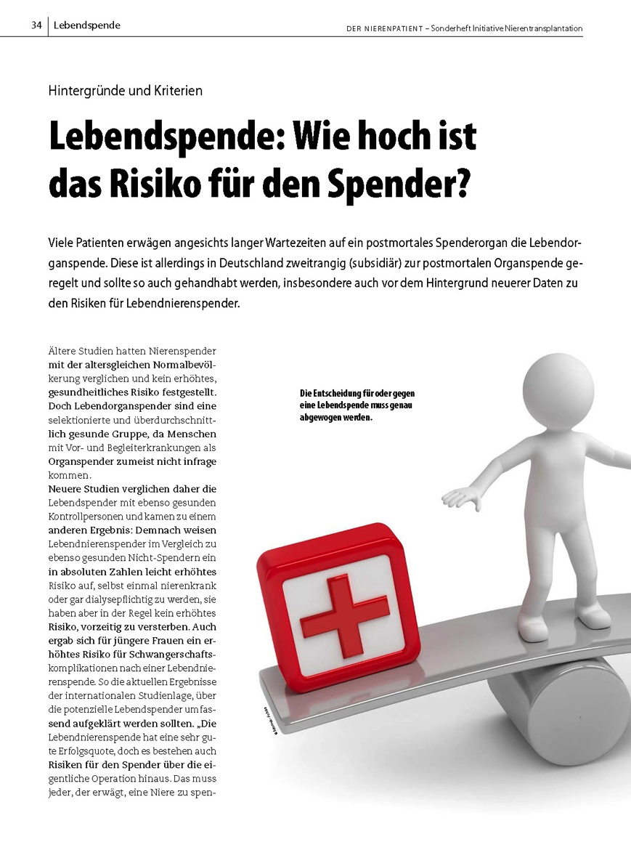
Sonderausgabe / Inhalte
Informationen rund um das Thema NTX und Organspende

Slide 47
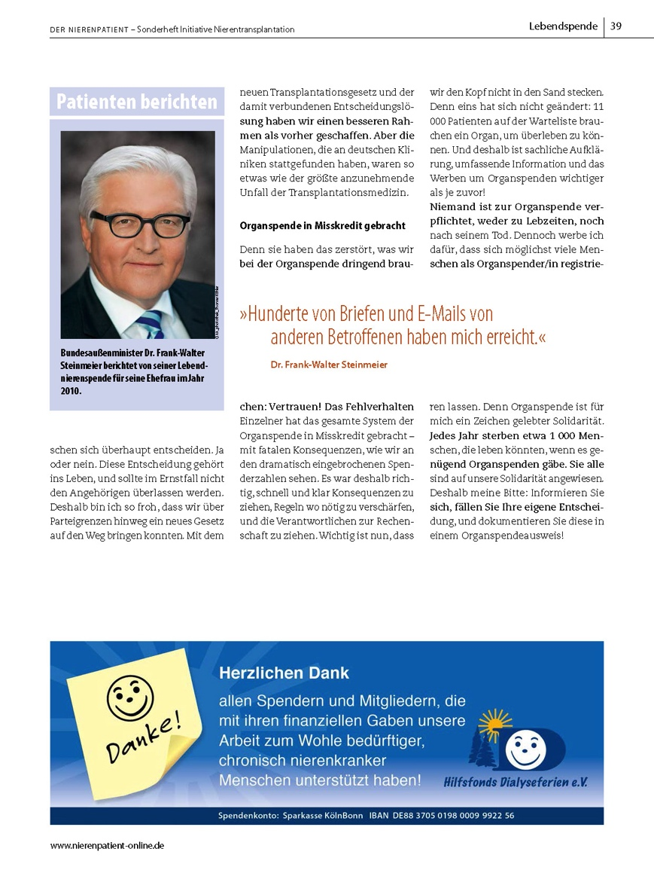
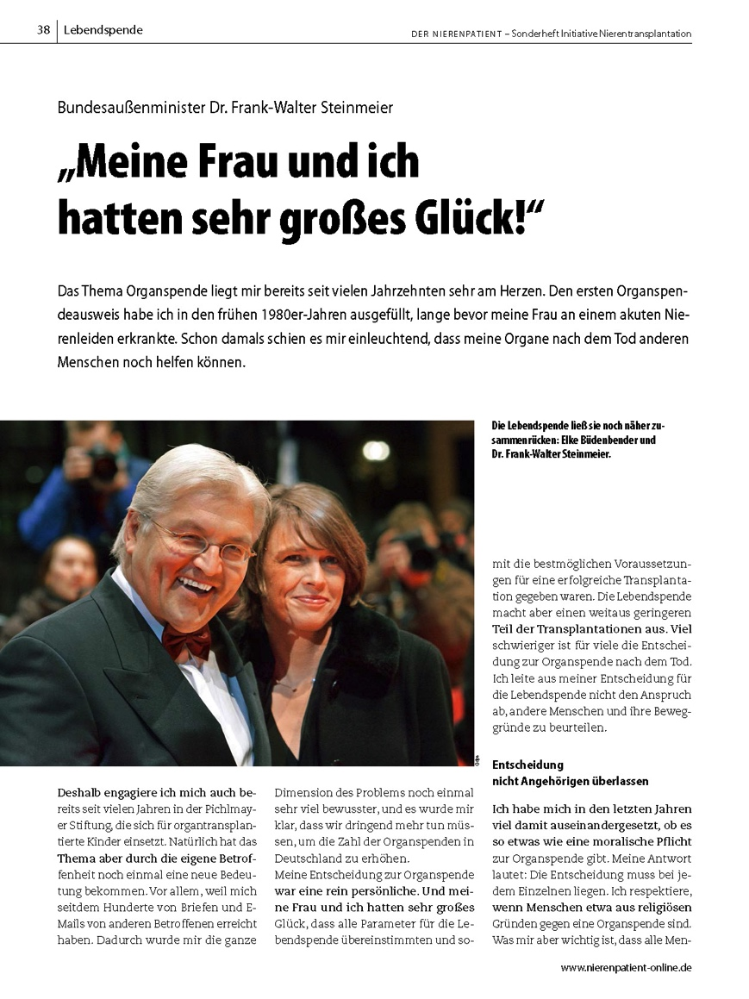
Sonderausgabe / Inhalte
Beitrag von
Frank-Walter Steinmeier aus Sicht des Lebendspenders

Slide 48
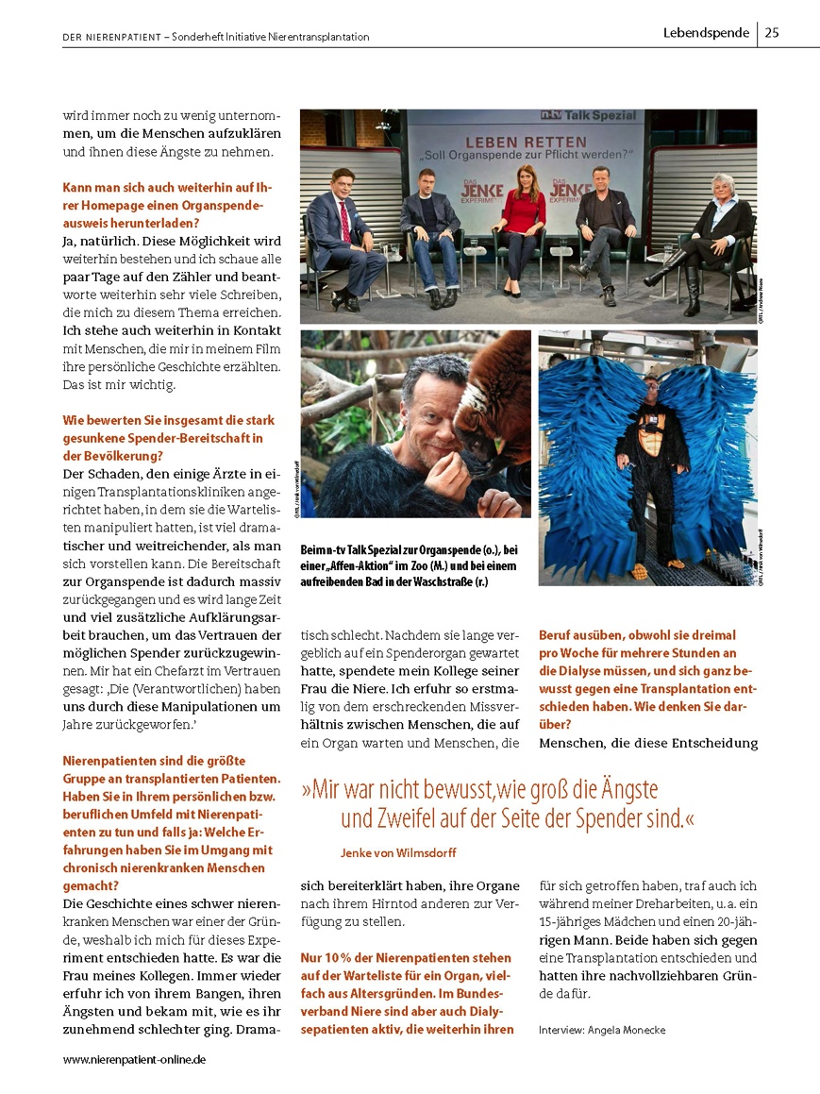
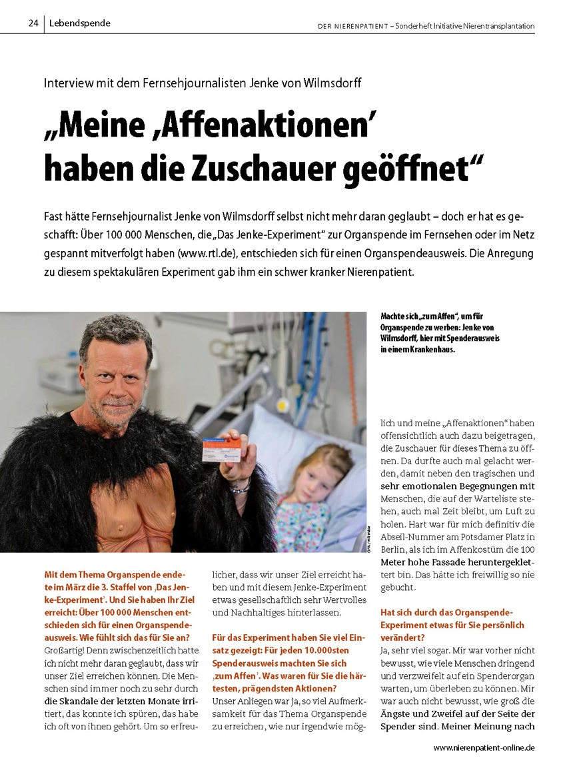
Sonderausgabe / Inhalte
Interview mit
TV-Moderator Jenke von Wilmsdorf

Slide 49

Was hat Floege gesagt….?
Renale Denervierung ist (fast) gestorben
Wirklich Therapie-refraktäre Hypertonie ist sehr selten
Hypertonie
Diabet. Nephrop.
Revival für Pentoxifyllin
AKI
Elektronische Warnsysteme reichen nicht
Herz & Niere ist etwas Besonderes…
ACEi/ARB nicht absetzen
K⁺-Binder (o. Schleifendiuretika) bei S-K⁺ 
Trinkmenge 2 L in der Regel ausreichend
Chron. Niereninsuff.
Drastischer Rückgang der Spender
Aufklärung ist nötiger denn je…
Nierentransplant.

